Slide 1
Insurance management system
By team zero risk:
Sreya Vallabhaneni
Abhinav Palem
Venkata Abhishek Tiruchunapalli
Venkatesh Gopinath

Slide 2
Project statement:
Creating an Insurance Management System for users with different functionalities depending upon user role (Customer/Admin)

Slide 3
Project Technical overview
Project executed using Apache Netbeans 15 with Java, Java FX and FXML
Used maven dependencies to inject fxml and mysql jar files
MVC Framework with Java
FXML Doc(V) || Java Files(C) || User and Insurance(M)
Connection with database – JdbcDAO

Slide 4
Database And Models
MySQL database - Two tables
user_registration - (Full name, email id, password)
Insurance_plan – id, email_id, insurance_type, insurance_name, monthly_premium, tenure
Designed a JdbcDao class to connect MySQL with Java controllers.
JdbcDAO takes care of all CRUD operations
Created a UserSession.java file to keep track of the user information till the end of session.
Insurance.java - Model to retrieve all insurance data
Mysql -> List<Insurance> -> Java class Controller -> fxml

Slide 5
DATAbase operations
Implemented insertRecord() and addRecord() to add insurance plan to the MySQL database.
Implemented setRecord() method to update the insurance plan.
Implemented getRecord() and searchRecord() methods to search and get insurance plan information of the user logged in from MySQL database.
Used deleteRecord() method to delete current insurance plan of the user from MySQLdatabase.

Slide 6
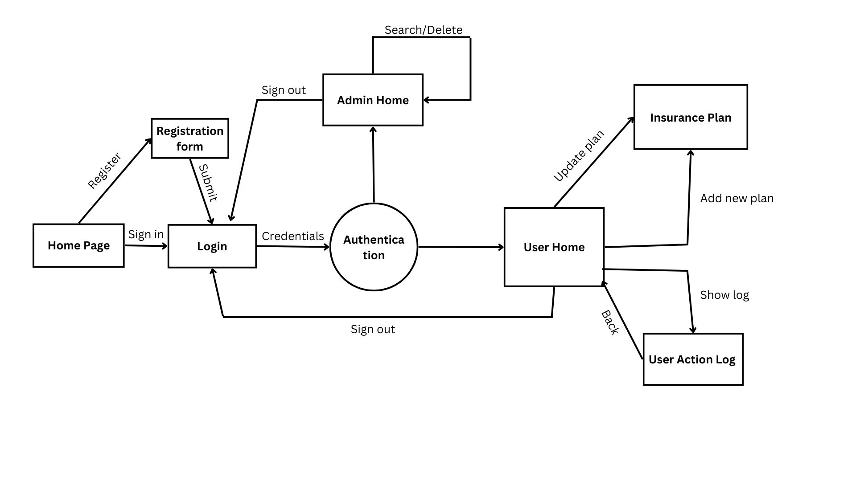
System DESIGN

Slide 7
Operations Overview
Registration/ login
Insurance planning (CRUD operations)
Activity Log
Admin (Search and Delete)

Slide 8
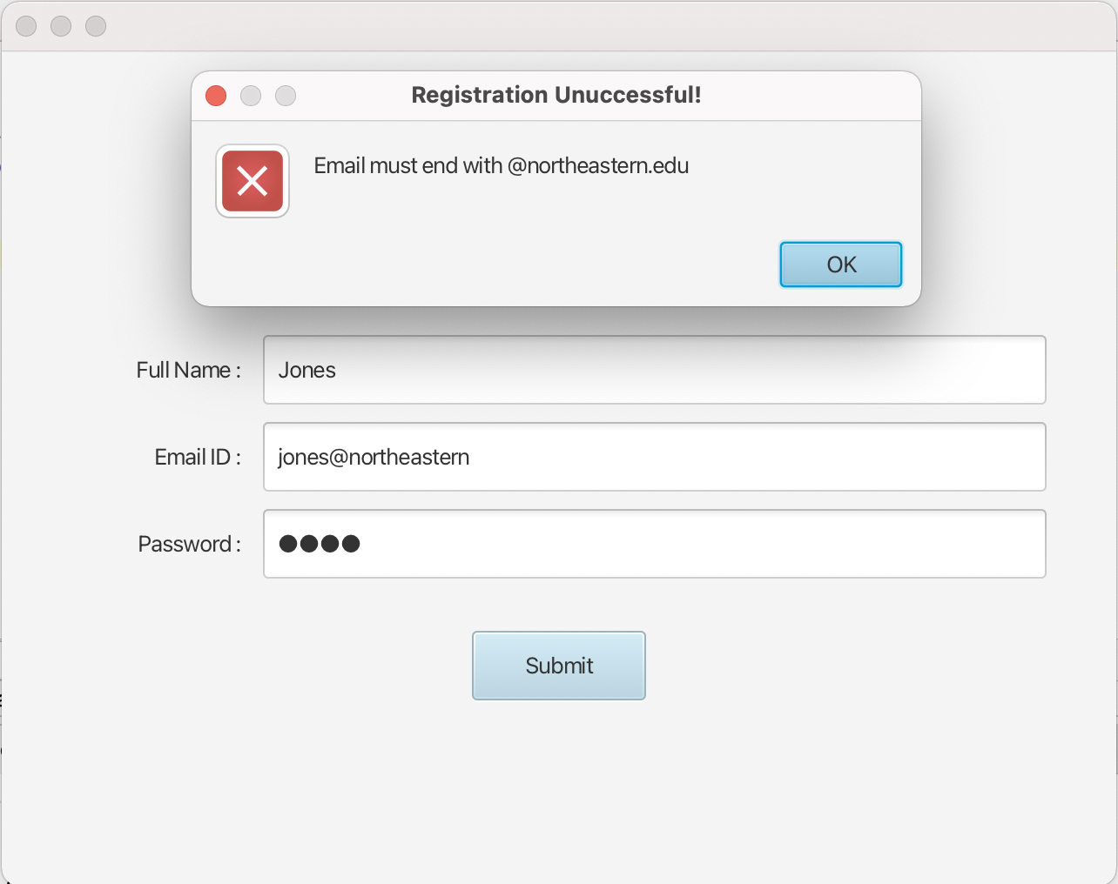
Registration page
Home.fxml -> Primary.fxml (registration page)
Alerts prevent user from registering without entering all data in correct format
Submit button prompts java file to connect to DB and add customer to User DB
On Successful registration -> Login.fxml

Slide 9
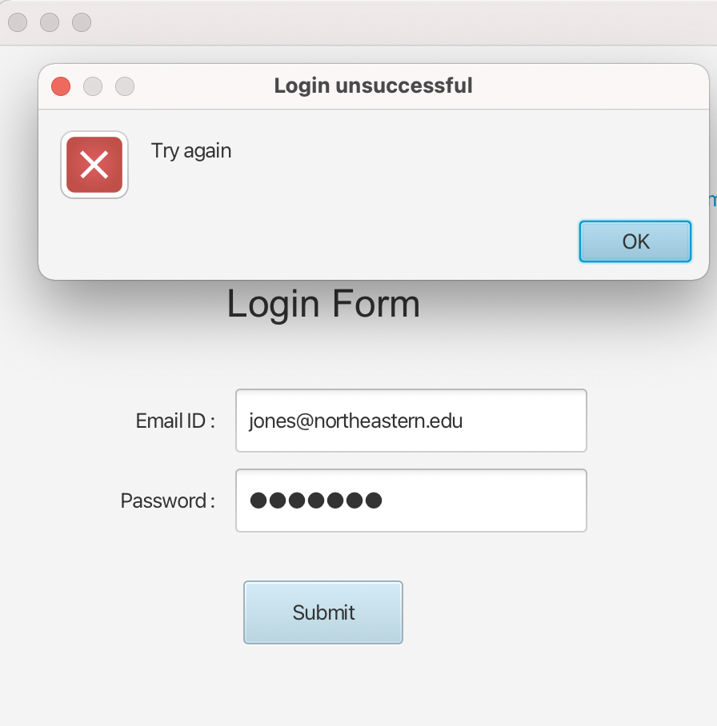
Login page
Primary.fxml -> Login.fxml (Login page)
Submit button -> searchAdminRecord and searchRecord functions are prompted
Alerts raise on wrong credentials by user
On Successful Login -> UserHome (PostLogin.fxml)

Slide 10
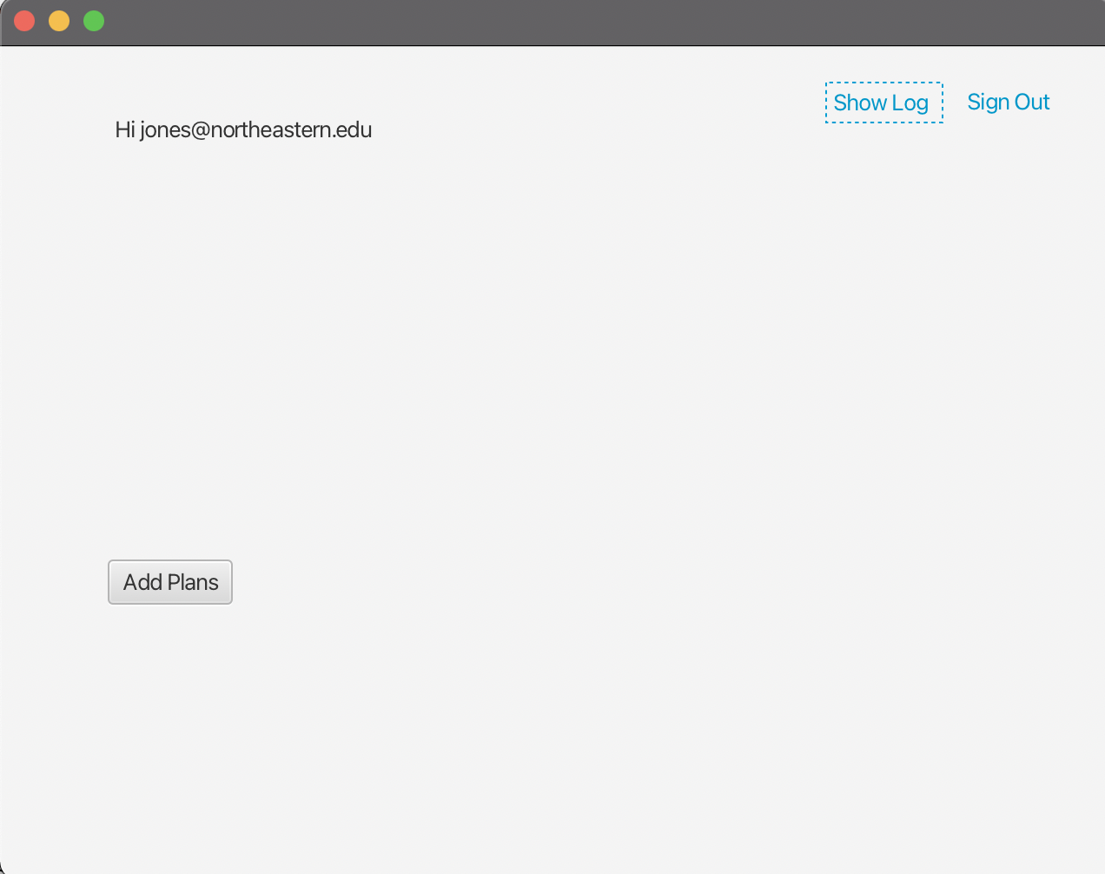
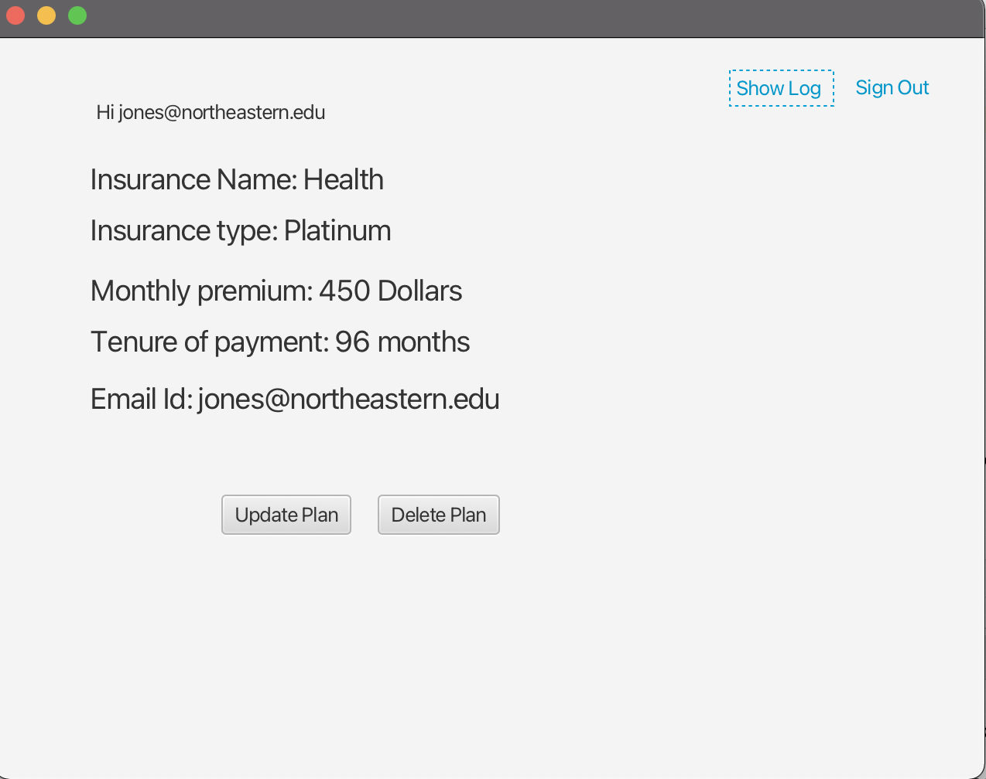
USER HOME
PostLogin Controller implements the Initiliazable function
We override initialize function to show labels, text and buttons on page load.
Using List Iterator, data is converted and displayed on PostLogin.fxml view page
Read Operation – On page load, the getRecord() function runs and stores data into List<Insurance>
If the User has no plan setup, the 'add plan' button is visible else 'update plan' and 'delete plan' buttons are shown
Clicking any of these buttons leads you to add/update plan page, delete button refreshes the page with your insurance plan removed from DB.

Slide 11
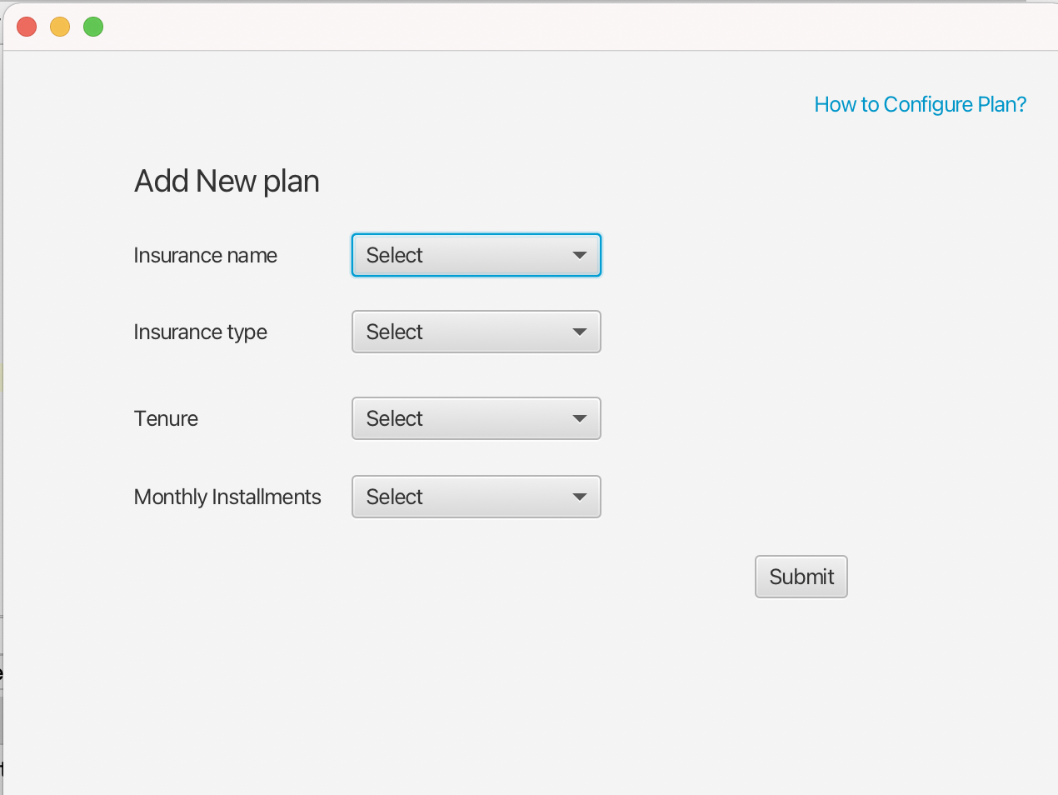
ADD Plan
PostLogin.fxml -> addplan.fxml
Add plan button prompts Add new plan page for first time users to add a new Insurance plan.
Alerts prevent user from submitting the plan without selecting all fields
Submit button prompts java file to add Insurance information to the database.
On submitting the plan --> PostLogin.fxml

Slide 12
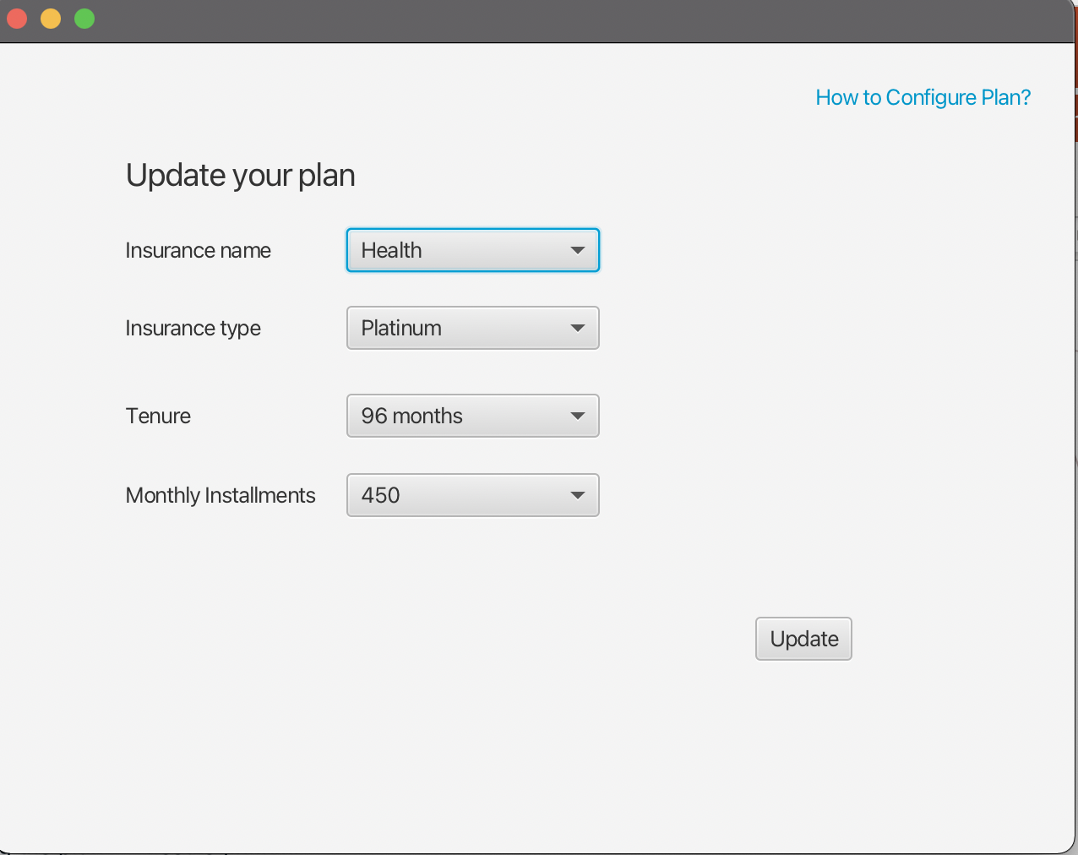
UPDATE PLAN
Update button is visible only if the user has an existing plan in the database.
PostLogin.fxml --> addplan.fxml
Update button retrieves data from Database and shows it as default in the ComboBox in fxml
Update button prompts java file to update current Insurance information in the database.
On updating the plan --> PostLogin.fxml

Slide 13
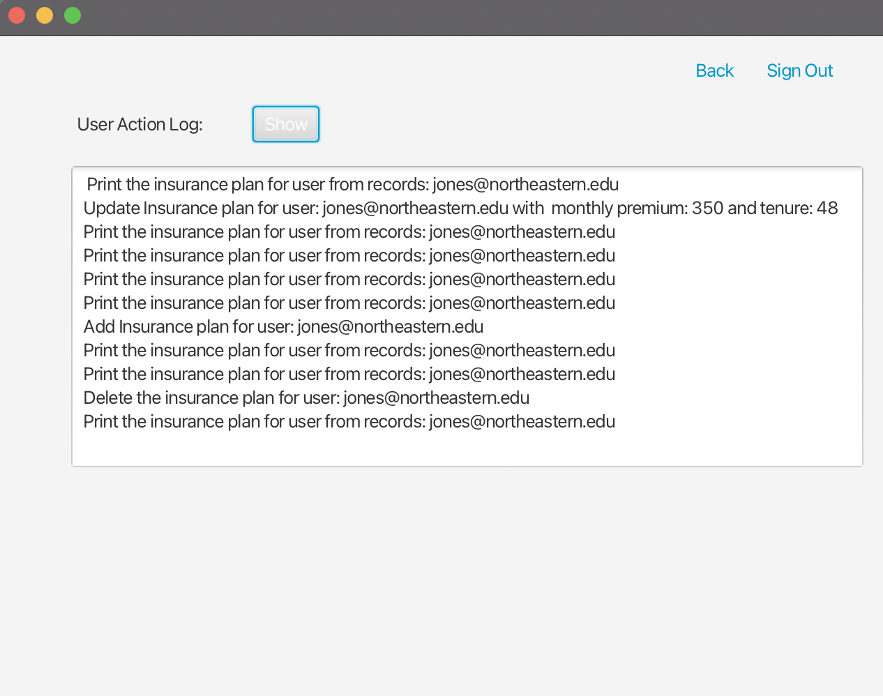
Activity LOG
For every DB action performed, data is pushed into a stack in the push_log instance.
Button(show)-> Prints all the actions performed by customer after logging in.
To print the log, stack is emptied using pop()
To store the order of actions after printing once, we use Deque.
Button (back) -> PostLogin.fxml
When user hits on back button, all data get pushed back to the stack from deque retaining its original order.

Slide 14
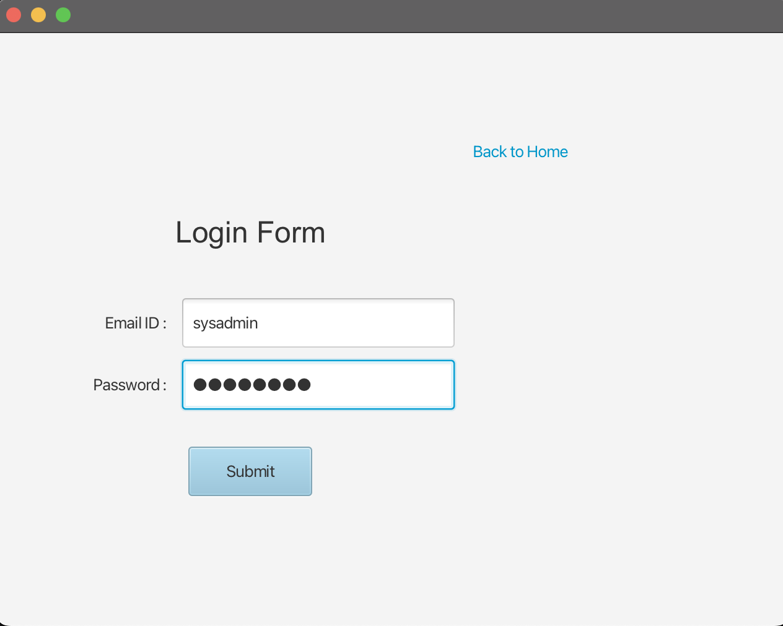
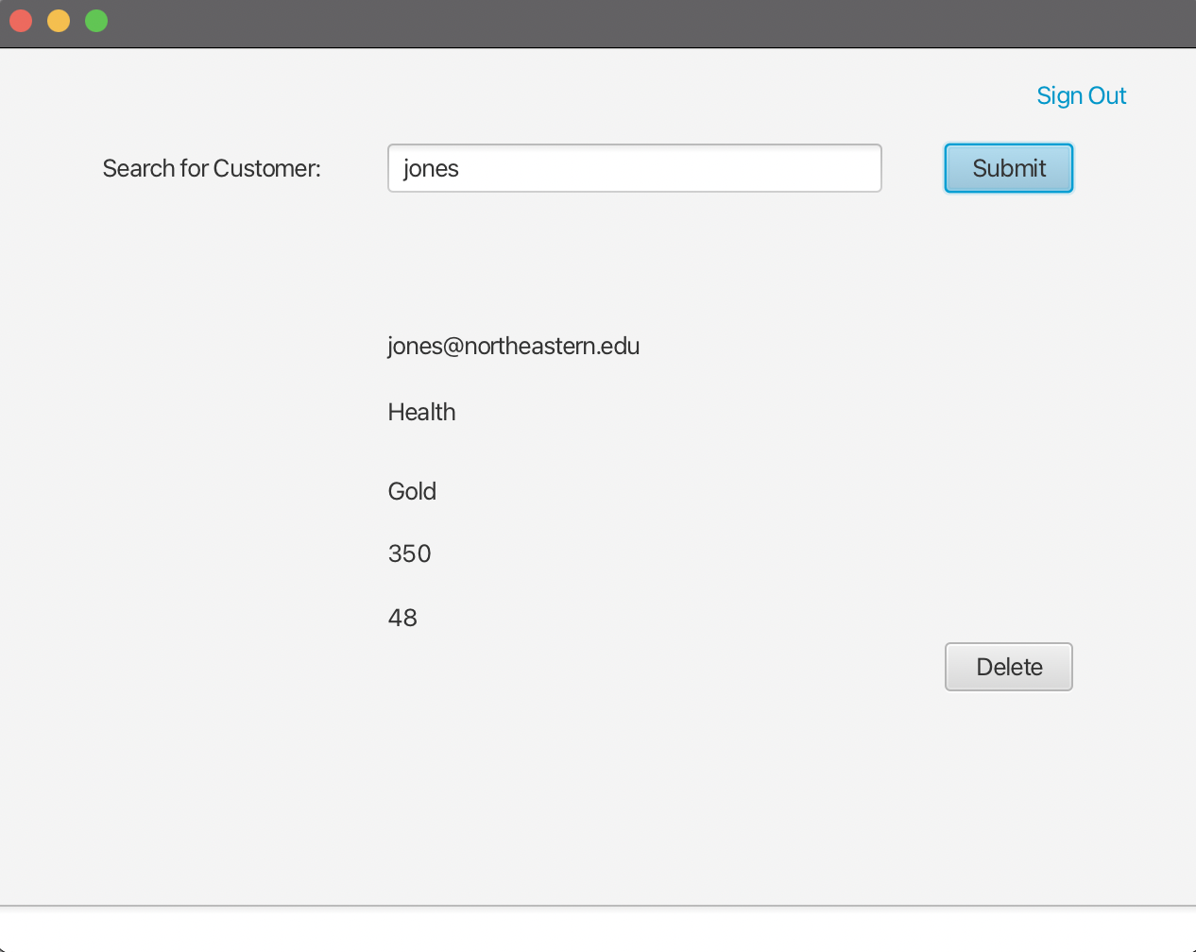
Admin- (Search and delete)
Only Admin has credentials without @northeastern.edu. (Image1)
Admin enters string to search record-> returns insurance plan from database using sql query.
Delete-> deleteRecord instance removes the user from Database.
Signout-> Login.fxml
New admin creation -> Hard coded into JdbcDAO.java / Adding into database

Slide 15
Future Scope
Adding 'Make Claims' page for users to claim insurance
Adding a chat box for users to speak to admin
Adding online payment option for users
Improving UI and add dynamic content on FXML pages
Adding option for customers to add more than one insurance plan.
Customer specific insurance plan based on factors like previous health ailments and lifestyle

Slide 16
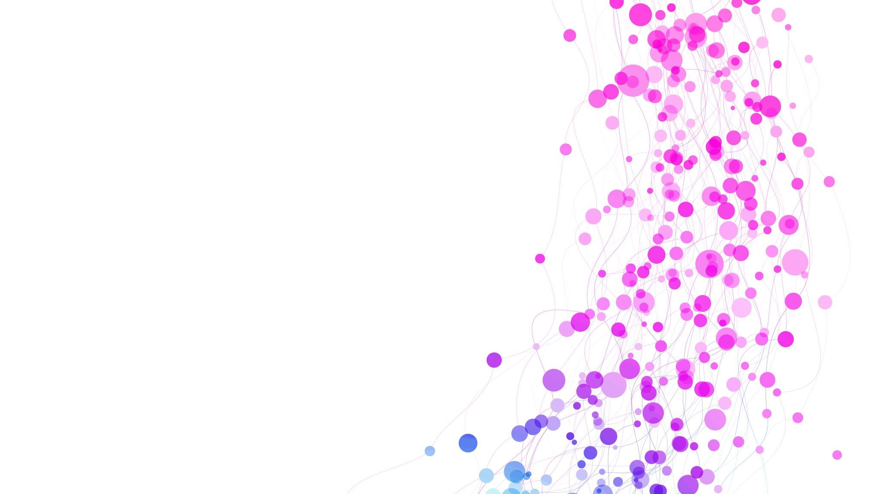
THANK YOU!

